Slide 1
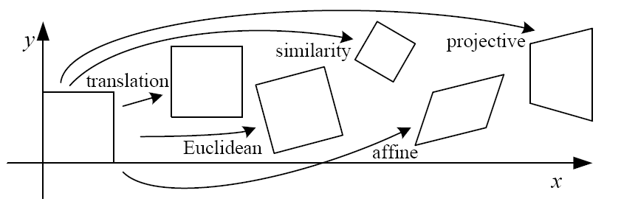
Image transformation

Slide 2
3d->2d trans
Perspective, orthographic, week perspective, perspective distortion/warping https://fstoppers.com/architecture/how-lens-compression-and-perspective-distortion-work-251737
Camera intrinsics
Camera extinsics
Radial distortion

Slide 3
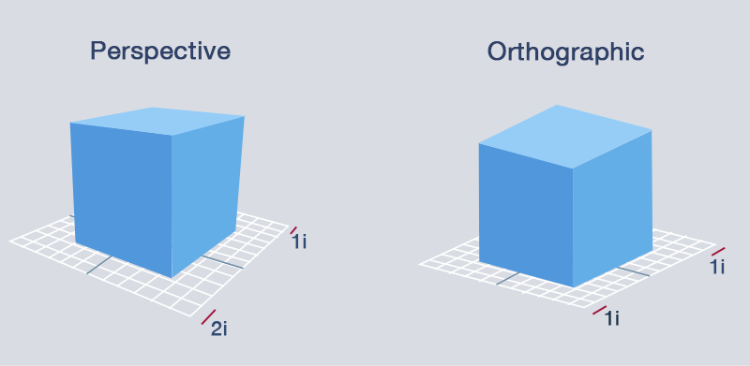
3D projection
3D projection is any method of mapping three-dimensional points to a two-dimensional plane.
Two types of projections are orthographic and perspective.

Slide 4
Perspective transformation
When dealing with imaged 3D scenes, we tend to use the image plane rather than the sensor plane which is flipped.
real-world object
image plane
sensor plane
focal
length f
focal
length f

Slide 5
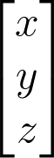
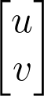
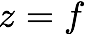
Perspective transformation
Perspective projection is a linear projection where three dimensional objects are projected on the image plane.
image plane
camera center
principal axis
Notes:
\begin{bmatrix}x
\\ y
\\ z
\end{bmatrix}
\begin{bmatrix}u
\\ v
\end{bmatrix}

Slide 6
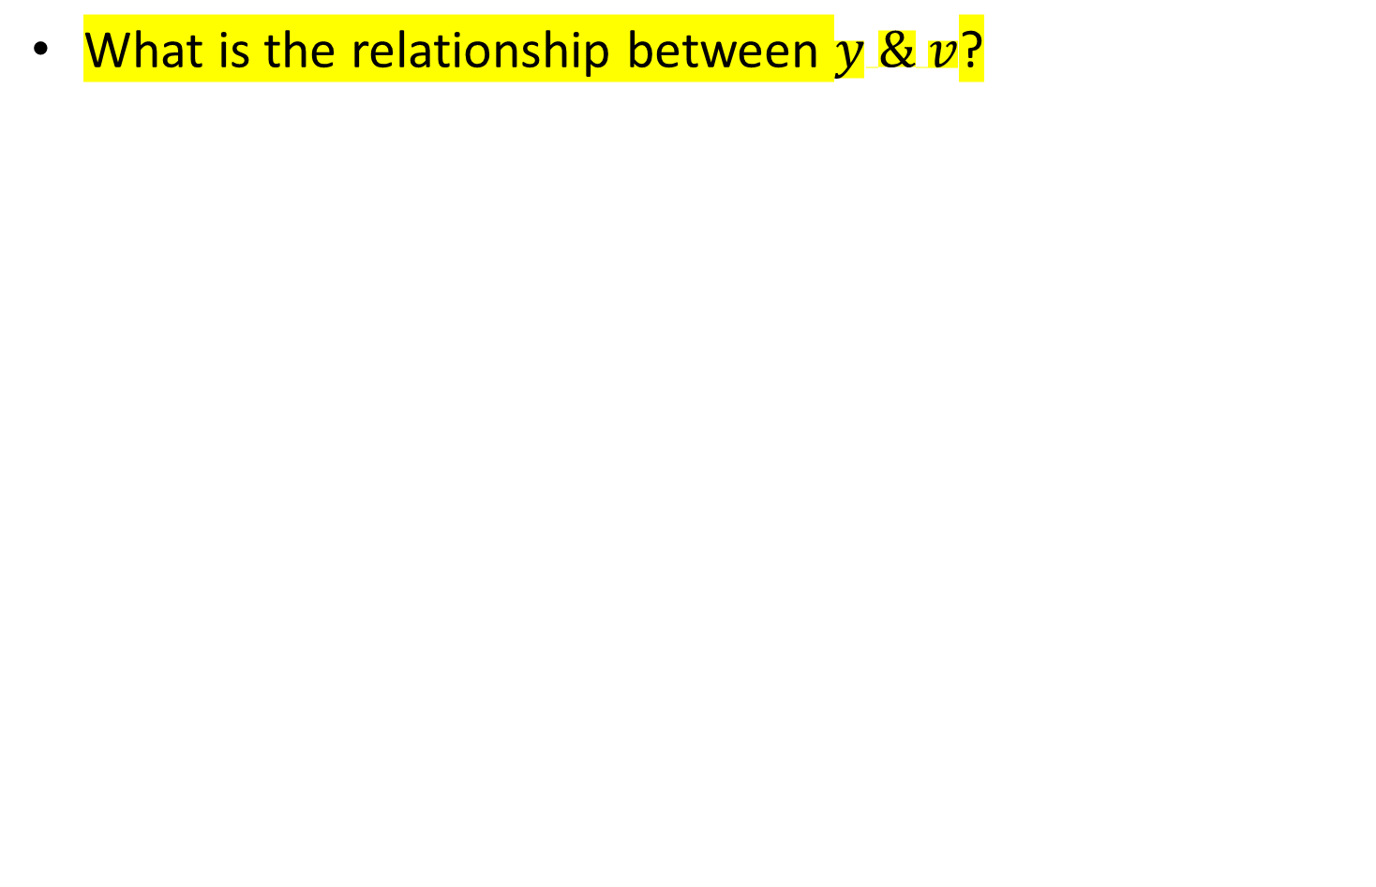
Perspective transformation
What is the relationship between $y \& v$?
image plane

Slide 7
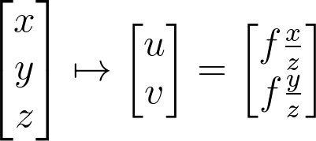
Perspective transformation
Using triangle proportions (Thales’ theorem) we can easily conclude that:
image plane
Notes:
\begin{bmatrix}x
\\ y
\\ z
\end{bmatrix}
\mapsto
\begin{bmatrix}u
\\ v
\end{bmatrix}
=
\begin{bmatrix}f\frac{x}{z}
\\ f\frac{y}{z}
\end{bmatrix}

Slide 8
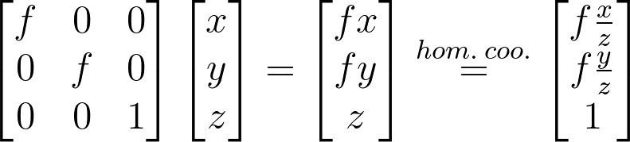
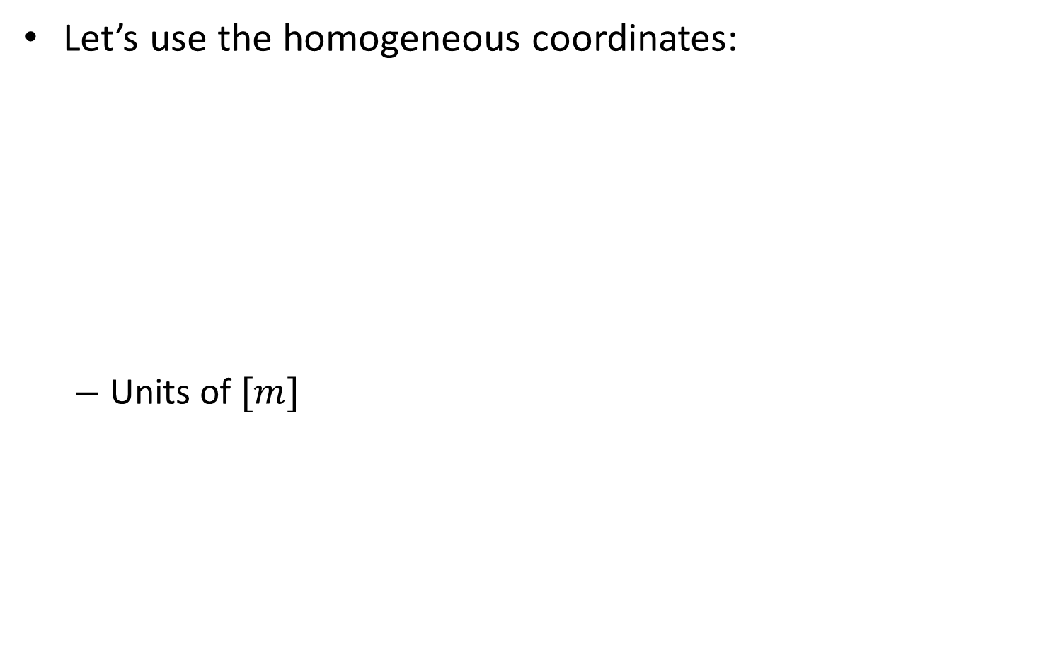
Perspective transformation
Let’s use the homogeneous coordinates:
Units of $[m]$
Notes:
\begin{bmatrix}f & 0&0
\\ 0&f &0
\\0&0&1
\end{bmatrix}
\begin{bmatrix}x
\\ y
\\z
\end{bmatrix}
=
\begin{bmatrix}fx
\\ fy
\\z
\end{bmatrix}
\stackrel{hom.\: coo.}{=}
\begin{bmatrix}f\frac{x}{z}
\\ f\frac{y}{z}
\\1
\end{bmatrix}

Slide 9
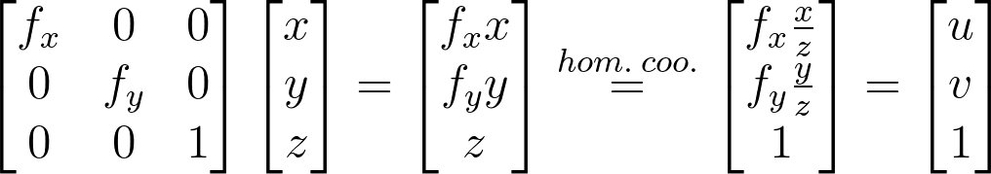
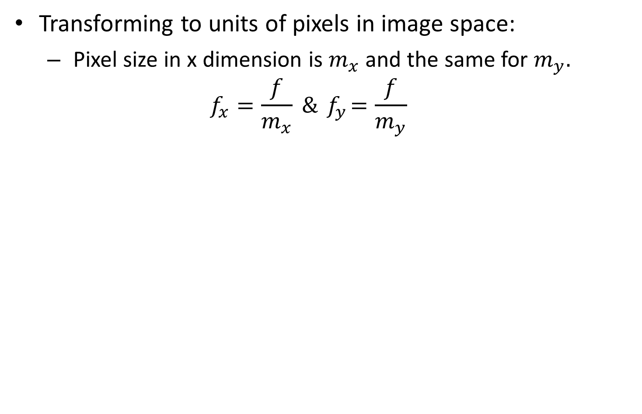
Perspective transformation
Transforming to units of pixels in image space:
Pixel size in x dimension is $m_{x}$ and the same for $m_{y}.$
$$f_{x}=\frac{f}{m_{x}} \&{ f}_{y}=\frac{f}{m_{y}}$$
Notes:
\begin{bmatrix}f_x & 0&0
\\ 0&f_y &0
\\0&0&1
\end{bmatrix}
\begin{bmatrix}x
\\ y
\\z
\end{bmatrix}
=
\begin{bmatrix}f_xx
\\ f_yy
\\z
\end{bmatrix}
\stackrel{hom.\: coo.}{=}
\begin{bmatrix}f_x\frac{x}{z}
\\ f_y\frac{y}{z}
\\1
\end{bmatrix}
=
\begin{bmatrix}u
\\ v
\\1
\end{bmatrix}

Slide 10
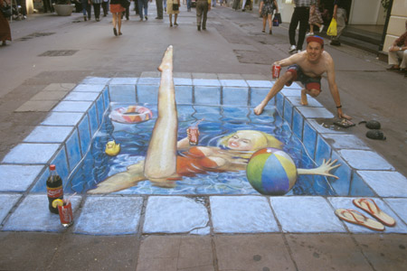
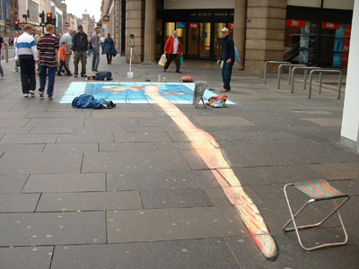
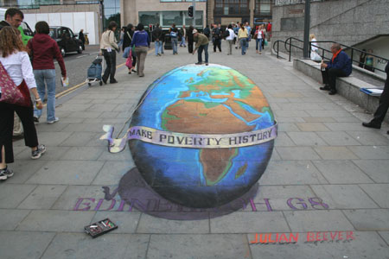
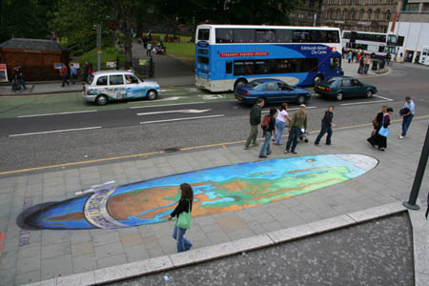
Street art- perspective manipulation

Slide 11
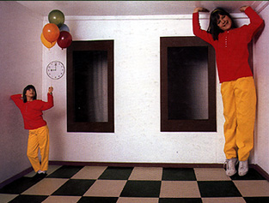
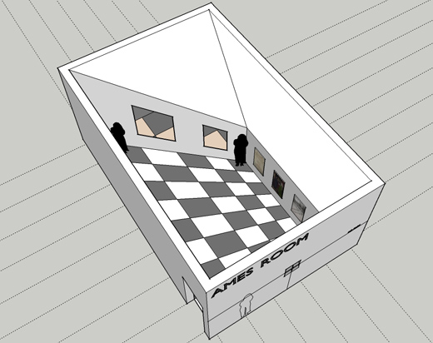
Ames Room

